Slide 1
Social Distancing Face Shield for COVID-19
Submitted by
Manthan Pawar
Zewen Wu
Guided by
Professor Vikram Kapila

Slide 2
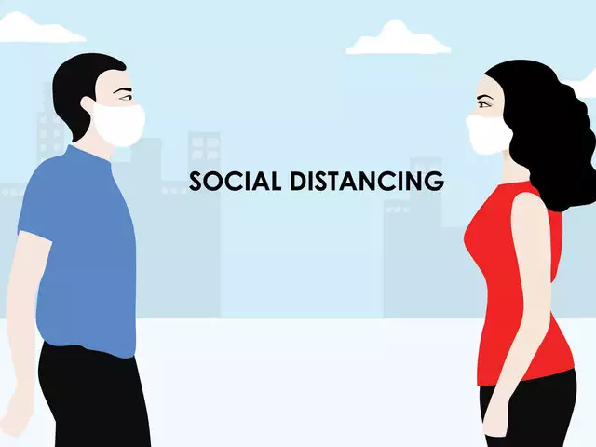
Social Distancing for COVID-19
People who are in close contact contract COVID-19
Social Distancing - Need of reducing the ways people come in close contact
CDC’s definition of social Distancing - you should stay at least 6 feet (2 meters) from other people

Slide 3
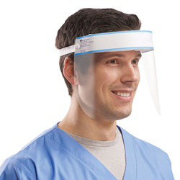
Face Shields - COVID-19
Study done by National Institute of Allergy and Infectious Diseases -
One of the silver linings of this pandemic
Offer more effective protection against coronavirus than masks and should be worn by the public whenever they leave home.
More effective than masks at protecting the eyes, nose and mouth from Covid-19 infection

Slide 4
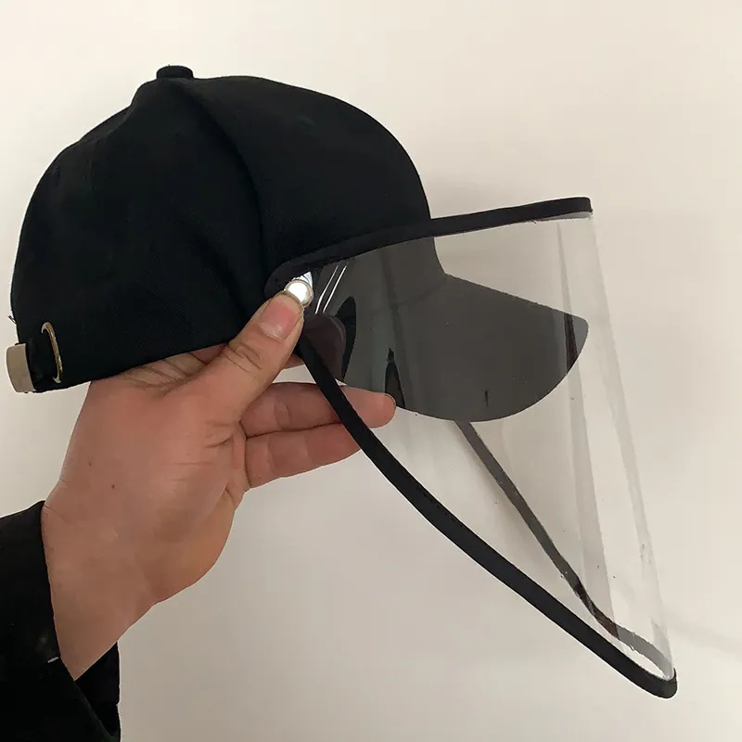
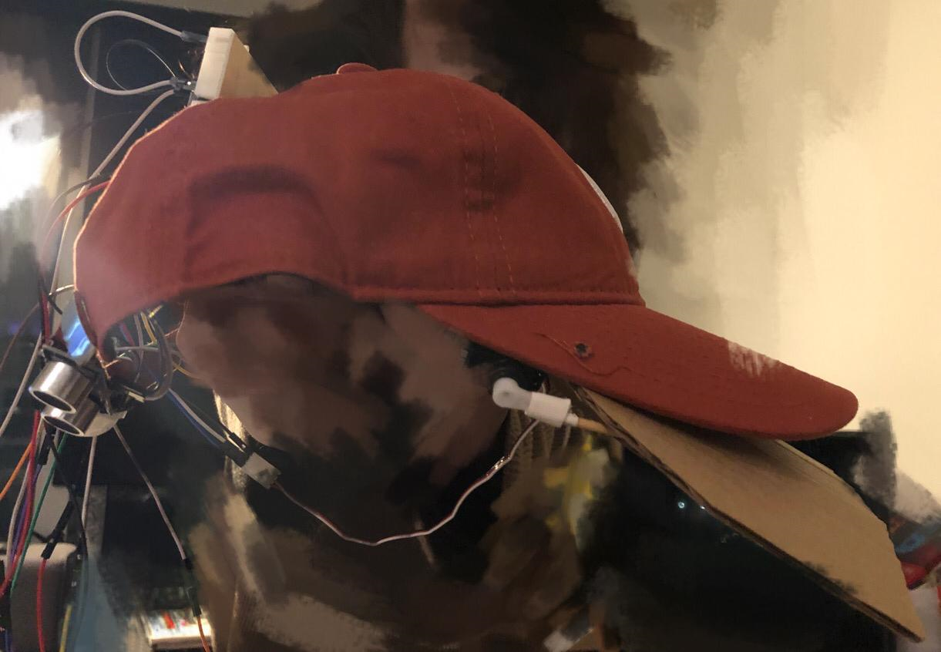
Proposed Solution
A cap whose shade converts into a face shield when it detects a presence of human within 6ft radius from the user and notifies the user.
Some adjustments for the prototype

Slide 5
The device
Detection of human motion using PIR Sensor
Measurement of actual distance of human movement from the user using ultrasonic
Face shield flap actuated by servo with user defined angle using an encoder
Notifies user about the criticality of the distance based on LED brightness and vibration intensity of vibration motors

Slide 6
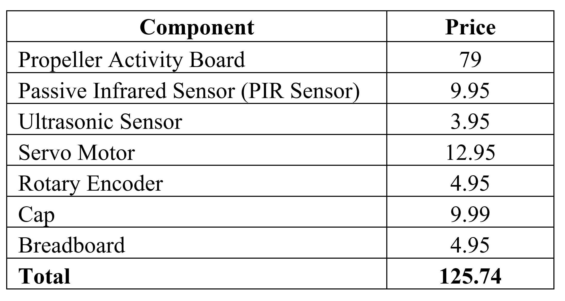
Bill of Material

Slide 7
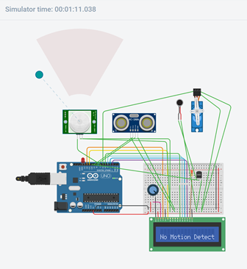
Simulation Prototype
Following components are used in the simulation:
Arduino UNO
LCD Display
Passive Infrared Sensor (PIR Sensor)
Ultrasonic Sensor
Vibration Motor
Servo Motor

Slide 8
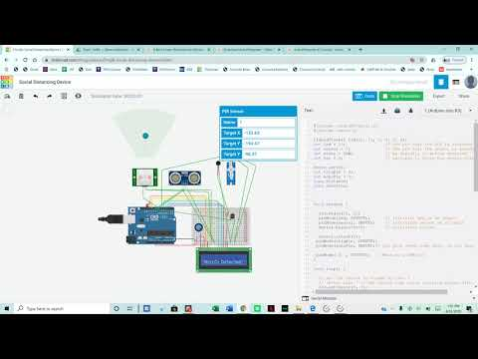
Simulation Prototype

Slide 9
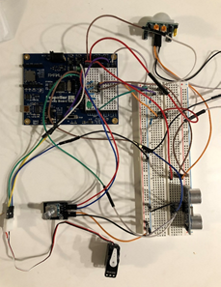
Hardware Prototype
Following components are used in the prototype:
Propeller Activity board
Passive Infrared Sensor (PIR Sensor)
Ultrasonic Sensor (HS-SR04)
Servo Motor
LED (On-board LEDs (Pin 26 and Pin 27) are used as well)
Rotary Encoder
Push Buttons

Slide 10
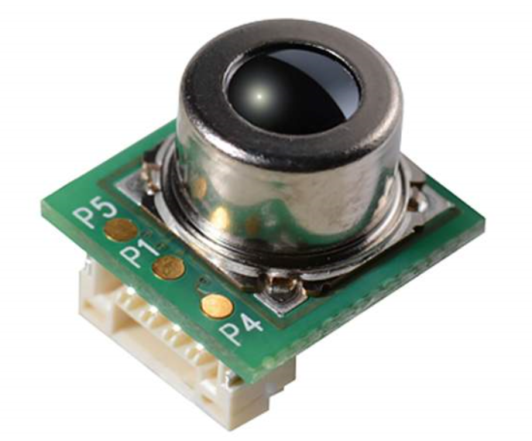
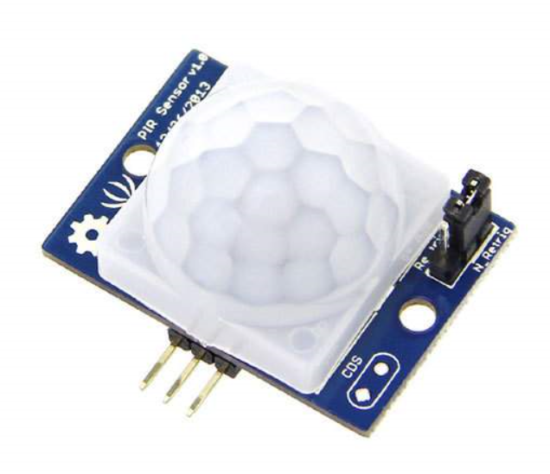
WHY PIR
Human Presence: infrared thermal sensor D6T-8L-09 developed by Omron
Motion Detection: PIR, which is an electronic sensor that measures infrared (IR) light radiating from objects in its field of view
Since we are intended to use OpenCV for human detection in our final project, PIR is cheaper and it is able to show how the device works in some cases (eg. User waits in a long queue)

Slide 11
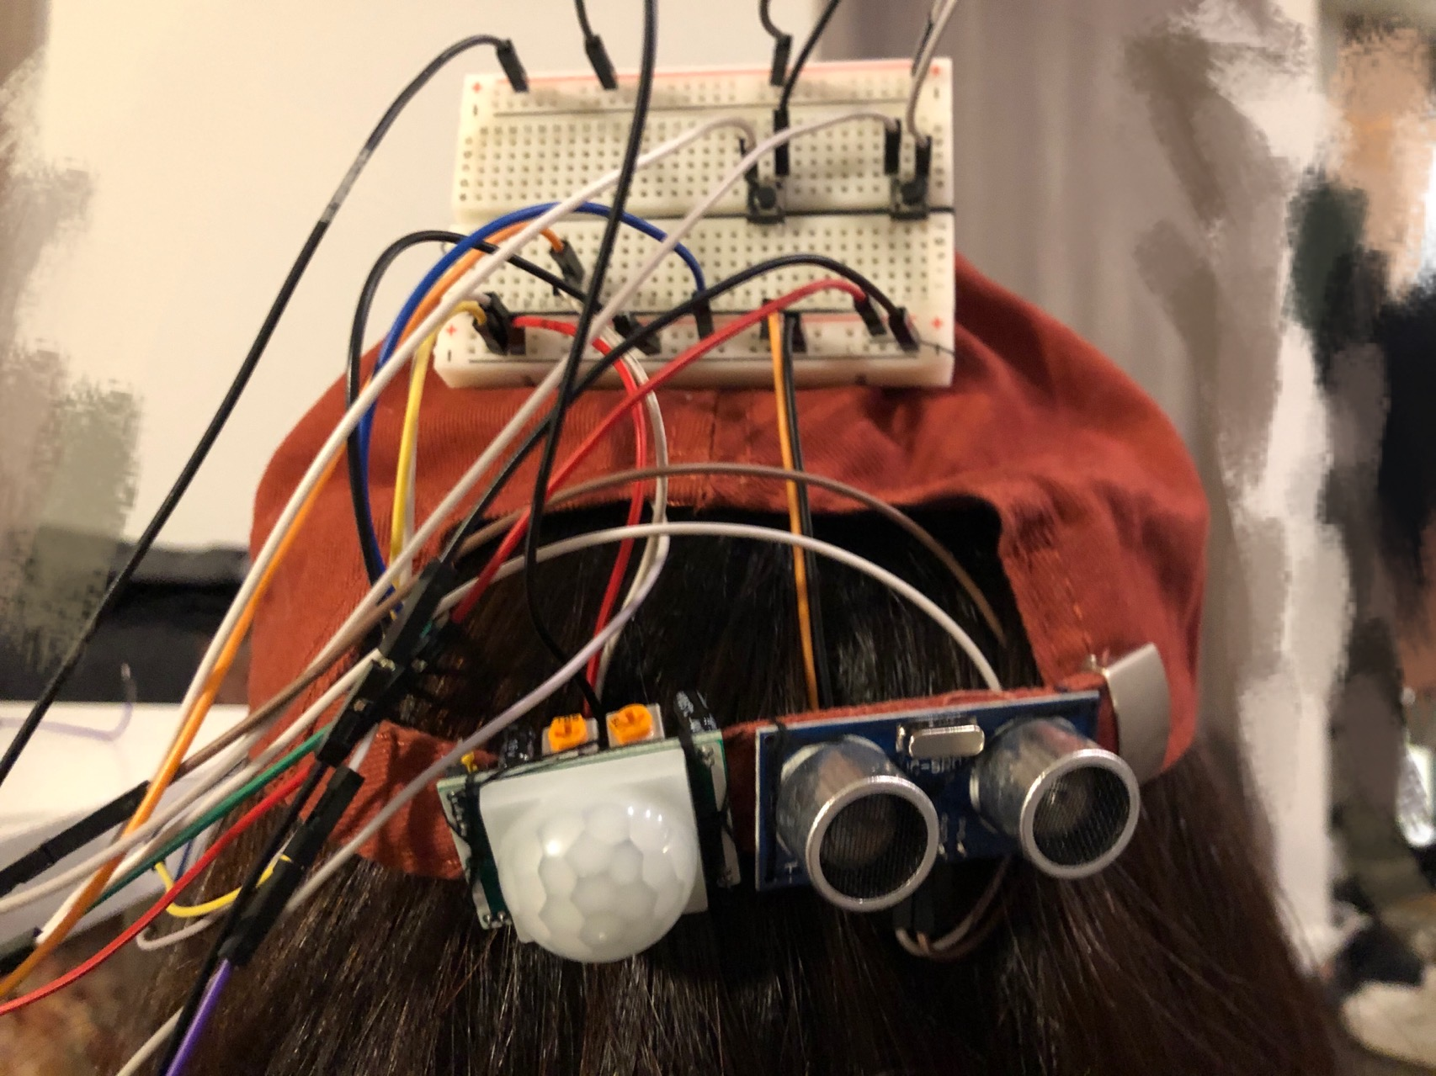
Prototype
Button A
Button B
Rotary Encoder
Servo Motor & Rod
Paper Shield
PIR
Ultrasonic Sensor

Slide 12
User interface
Overall procedure of user interface:
a) turn on the power;
b) press button A (green LED will be on, which indicates that the user can start set the rotation angle of the mask based on personal preferences);
c) rotate the rotary encoder to adjust the setting (the default rotation angle is 90 degree);
d) press button A to activate the system (Pin 26 and Pin 27 indicate if the surrounding environment is safe);
e) press button B so that the system will return to its initial state (Green LED will be off and button B can be pressed anytime during the progress).

Slide 13
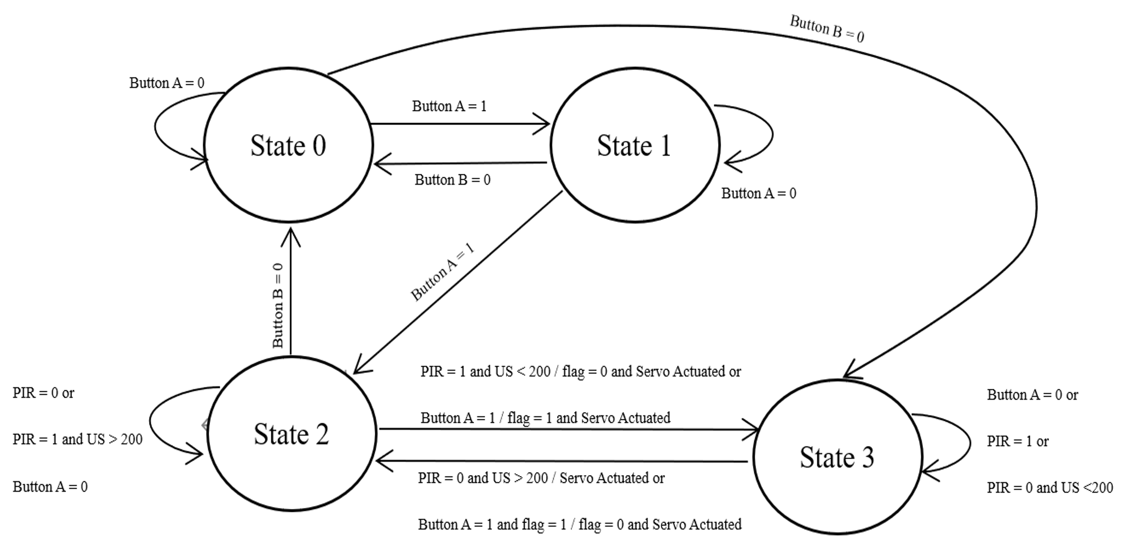
Finite State Machine (FSM)

Slide 14
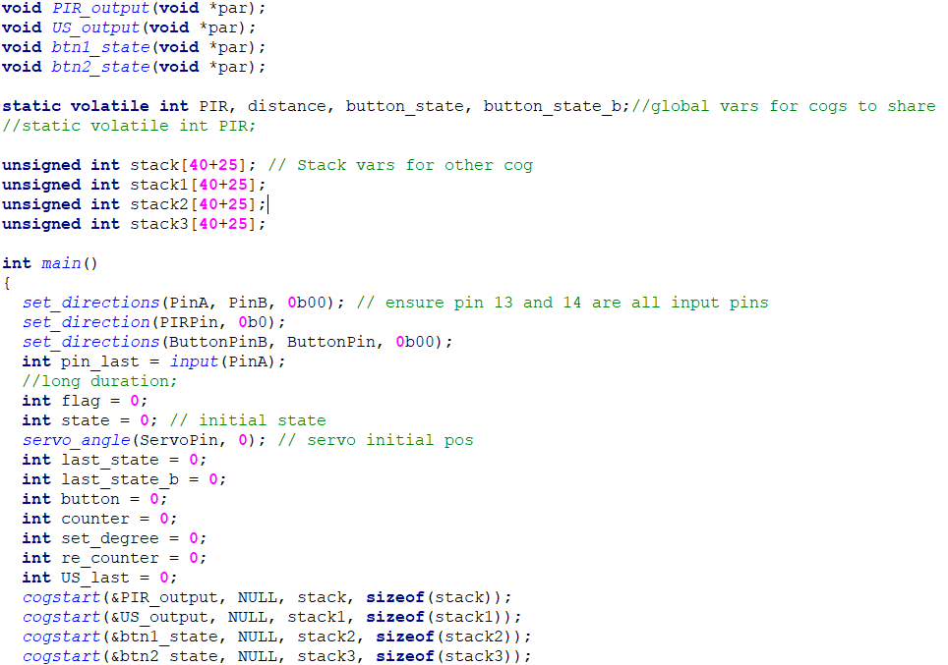
Code Breakdown
Cog 0: FSM, Rotary Encoder & Motor Actuation
Cog 1: PIR Sensor
Cog 2: Ultrasonic Sensor
Cog 3: Button A
Cog 4: Button B

Slide 15
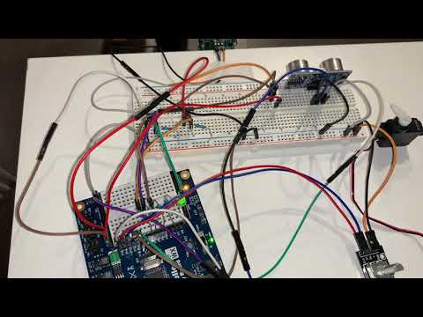
Proof of Concept
Default Setting: Servo Rotates 90 degree
Arbitrary Setting: User sets rotation angle via rotary encoder

Slide 16
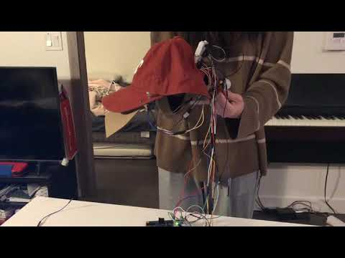
Prototype Demo

Slide 17
Future Scope
One camera actuated by a stepper motor / two cameras
Simple human detection algorithm, assisted with OpenCV
Distance estimation using RGB-D camera
Set a serial communication between Raspberry Pi and Propeller
CAD model of the final product
Develop better prototype once Makerspace is open

